Slide 1



System Implementation
Inventory Management System

Slide 2
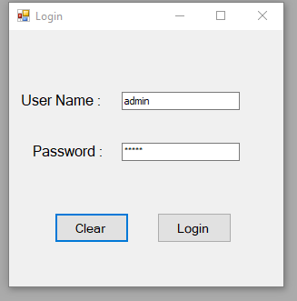
User Login
3 different login options
Admin
Manager
Employee

Slide 3
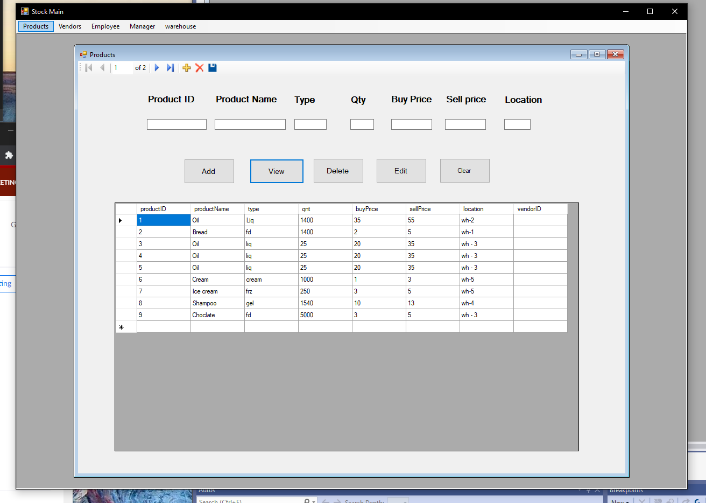
Products page
Enables you to :
View your products
Add new product
Delete products
Edit products details

Slide 4
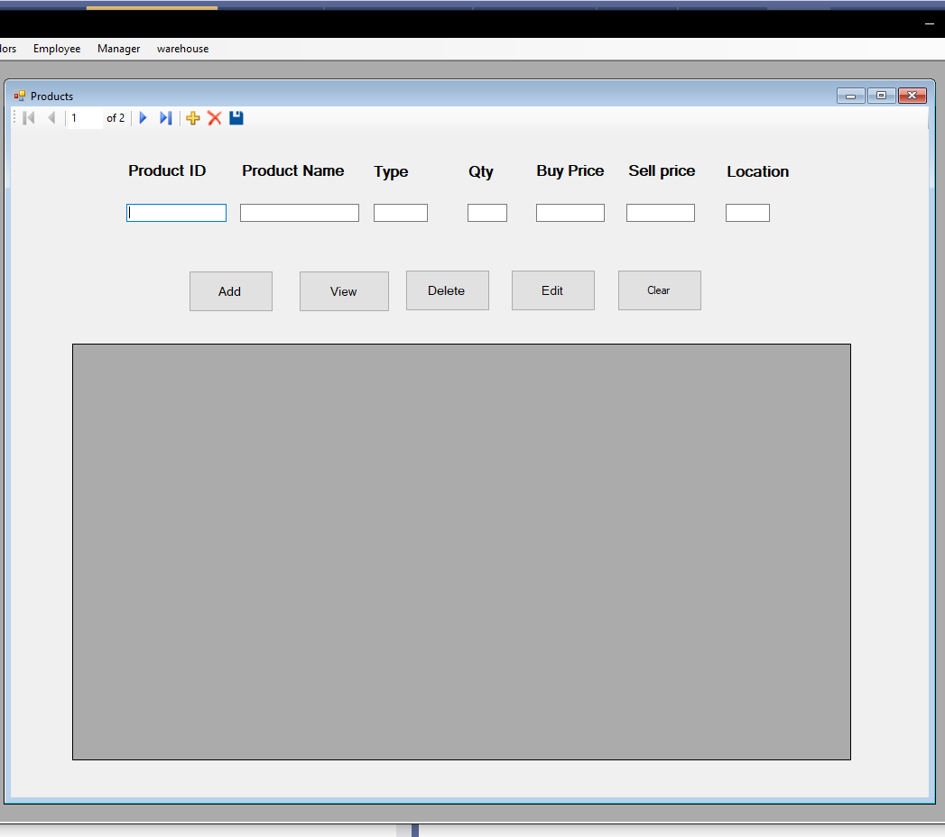
Vendor page
Enables you to:
View current warehouse vendor
Add new Vendors
Delete vendors
Edit vendors information

Slide 5
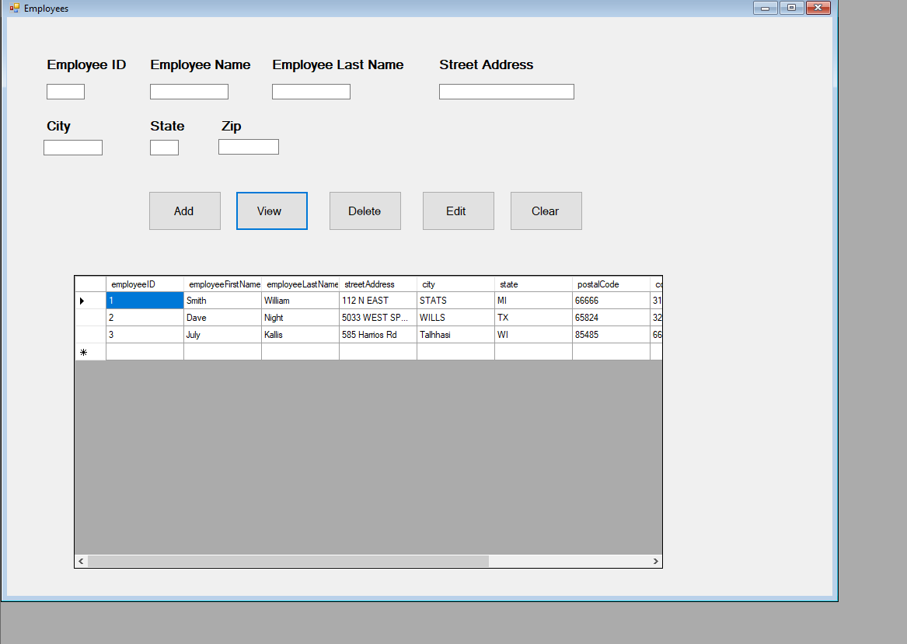
Employee page
Enables managers to:
View employee details
Add new employee
Delete employee
Edit employee information

